Slide 1
Columbia County Hazardous Material Transportation by Rail Plan
Columbia Local Emergency Planning Committee

Slide 2
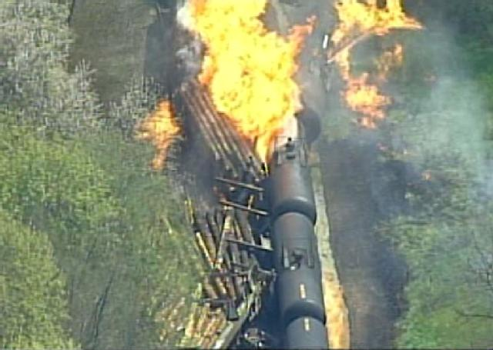

Slide 3
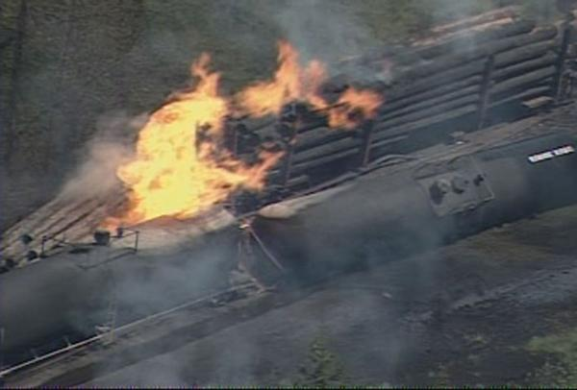
Notes:
A 20 car train segment was tied up at an intermediary siding located just North of the ODOT Gravel pile lot. Six of the tank cars were empty and the remaining 13 tank cars carried 28,000 gallons of Ethanol. The siding was located to the Hwy 30 side of the rail line. The logs of the derailed log car impacted the rear corner of the second to last tank car, splitting the tank and releasing Ethanol to ignite by the sparks and hot metal from the collision. The ruptured tank was engulfed by the flames. The Ethanol spilled onto the rail ties and rail bed, ignited by the fire, and exposed the tank car ahead and behind to fire.

Slide 4
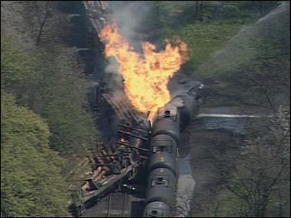

Slide 6
HM Transportation by Rail Plan
Developed by Bill Henle and Steve Hermann from
Henle Hazmat Training and Consulting, Inc.
Funding for the plan:
Oregon State Fire Marshal
Hazardous Materials Emergency Preparedness Grant $11,250
Port of St Helens Partnership Program Fund
$4,250

Slide 7
This HM Transportation Plan was developed for First Response Agencies not for State or Federal Response plan.

Slide 9
Core Group
Henle Hazmat Training & Consulting - 2
Oregon State Fire Marshal – 2
Portland Western Railroad – 2
OSFM Hazmat Teams - 2
Columbia County Emergency Management – 2
Columbia County Road Department - 1
Columbia 911 - 2
Fire Agencies – 3

Slide 10
Large Group Participation
Only one meeting
City Managers
Law Enforcement Agencies
Public Works
County Commissioners
County Agencies
State Agencies
Federal Agencies
Industry

Slide 11
Determine Top 10 most Hazardous Material Transported by Rail
Anhydrous Ammonia
Crude Oil – Sweet
Ethyl Alcohol
Sodium Chlorate

Slide 12
Plan is almost 220 pages
56 pages Heart of the plan
64 pages maps and plume Projections
40 pages SDS & Railroad guidelines
50 pages ICS forms

Slide 13
Operational Guide Lines
Size Up
Hazard Analysis
Risk Assessment
Strategic Goals (Objectives)
Tactics & Strategies
Debriefing
Foam Application Guidelines
Incident Command Guidelines – Single or Unified
Resource and Communications (dispatch) Guidelines

Slide 14
First Arriving Unit – Size-Up
____ Announce Incident via Radio, quick size-up, establish Command and name
_____Announce, via radio, the quick size-up info to all incoming units with approach instructions for incoming units. (up wind etc.)
_____Secure the scene. Set roadblock parameters.
_____Contact RR Crew, Identify need for Coast Guard/DEQ/OERS
_____Confirm Haz Mat level and confirm team response.
_____Identify Product. (Placards, Shipping Paper [Train Consist], Train Crew, Car Number etc.
Product Name:________________________________
DOT 2016 ERG Guide No.: __________ (Orange border pages)
_____Complete a Detailed Size-Up
Area impacted by vapors, spills etc. ________________
Public Exposed____________________________
Fire or Fire potential________________________

Slide 15
Hazard Analysis
Product Name:_______________________________________________
Flash Point:______________
Flammable/Explosive Range:_______________
Vapor Pressure: (water=25 mm/Hg)_______________
Vapor Density: (Air=1 <1 Rise >1 Sink) _______________
Corrosivity: (Acid or Caustic)______________
Solubility: (Soluble-Yes or No)_____________
Toxicity: (TLV, IDLH)____________
DOT 2016 ERG Guide Number: _______ (Orange border pages)
PPE requirements:
_____Contact Hazmat Team for assistance in interpretation of data.
_____If product is not identified or data is inconclusive, assume a worst case scenario and protect public/exposures.
_____Set Cold, Warm and Hot Zones if possible.

Slide 16
Lead Agency
Rail Response Zones North (RRZN): Clatskanie Rural Fire Protection District (CRFPD) Lead fire Jurisdiction
RRZN 1 Columbia/Clatsop County Line (milepost 70) to Clatskanie (milepost 62)
Notify: CRFPD, ODOT, CORD (Columbia County Road Department), Clatskanie Police, Clatskanie Public Works, CCSO, Clatsop or Columbia County Emergency Management

Slide 17
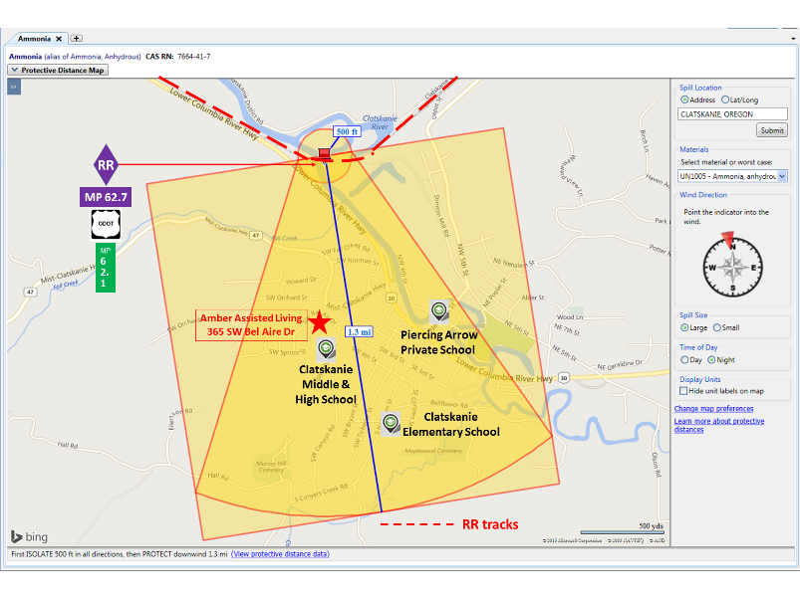

Slide 18
RRZC 4 Larsen Road (milepost 51) to Lindberg Road (milepost 44)
Notify: CRFR, ODOT, CORD, Rainier Police, Rainier Public Works, CCSO, COL EM

Slide 19
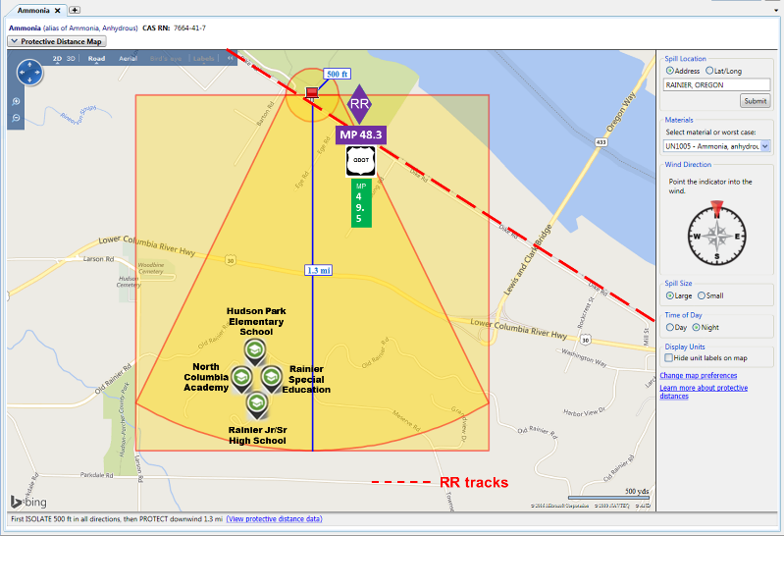

Slide 21
Supporting Agencies
Fire Agencies
Law Enforcement
Road Departments Public Works
Emergency Management
Railroad
911
OSFM
Hazmat Teams
OSP
ODOT
DEQ
Coast Guard
EPA
Many More …..

Slide 22
Safety Data Sheets and Railroad Chemical Guidelines

Slide 23
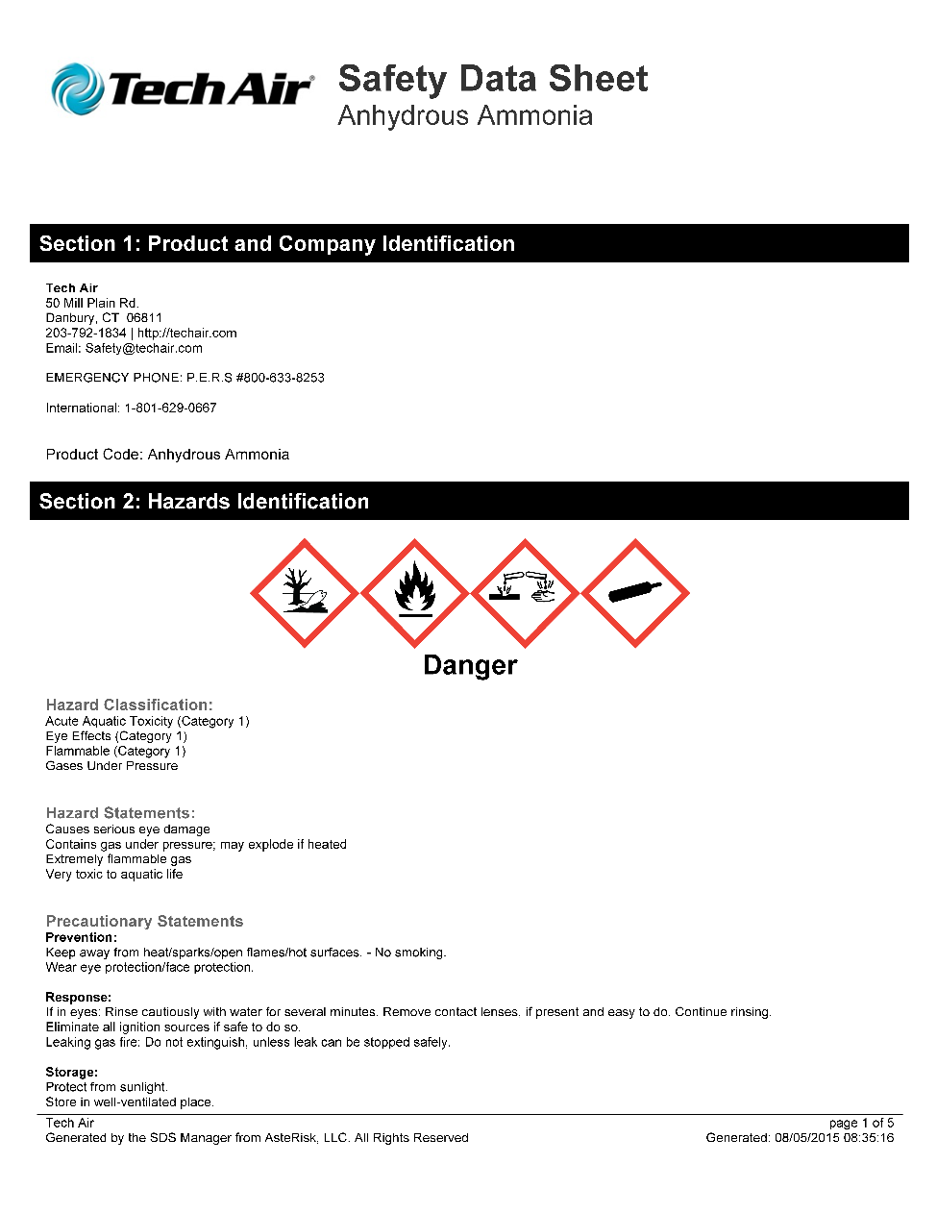

Slide 24
Anhydrous Ammonia:
A clear, colorless (corrosive) gas with a strong odor. Shipped as a liquid under pressure (railcar). Contact with the liquid can cause frostbite.
Normally non-flammable outdoors but can become flammable
(explosive) when confined (as in a building or structure).
Forms ammonium hydroxide, a strong corrosive (caustic) when mixed with water or moisture. Personnel should stay out of the vapors as they are highly toxic and corrosive to the skin and respiratory system.
Full turnouts with SCBA’s may be necessary for personnel near but not in the leak area. Exposure to or working in and around anhydrous ammonia requires full respiratory and full protective clothing (Hazmat Team Operation).

Slide 25
Response Packet for fire engines
Checklists
Plume projection maps
Railroad milepost maps
Foam Application Maps
Hazard Analysis Check Lists, SDS
Chemical Guidelines for four chemicals Tx by Rail
Apparatus Inventories
ICS Forms

Slide 26
What Worked for us
Henle Group keeping us on track
OSFM office support
Portland and Western Railroad
Strong Core Group

Slide 27
For any Information
Oregon State Fire Marshal Office
Chad Hawkins
chad.hawkins@state.or
Scappoose Rural Fire District
Michael Greisen
mgreisen@srfd.us
503-369-1767
www.srfd.us

